Slide 1
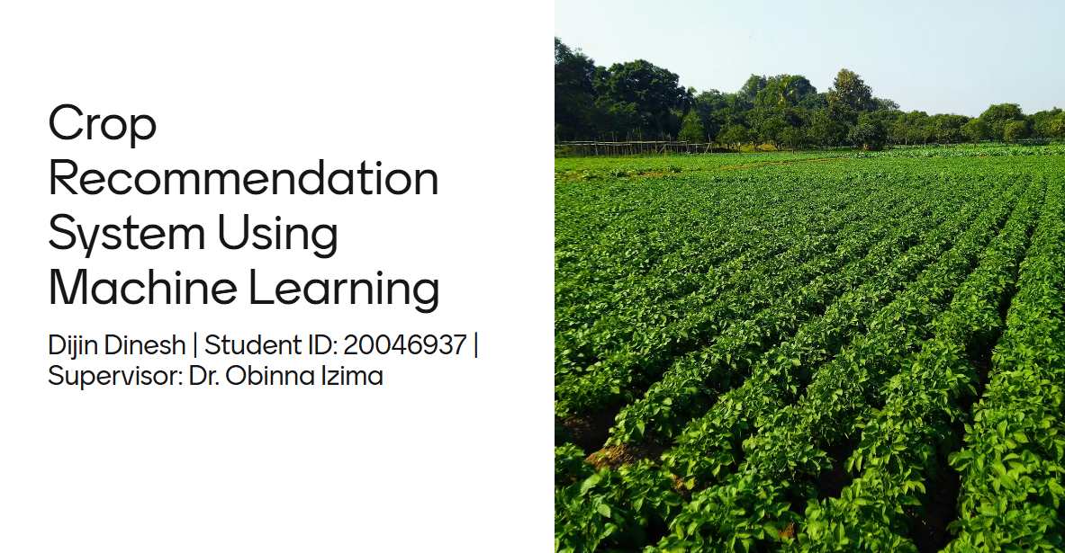

Slide 2
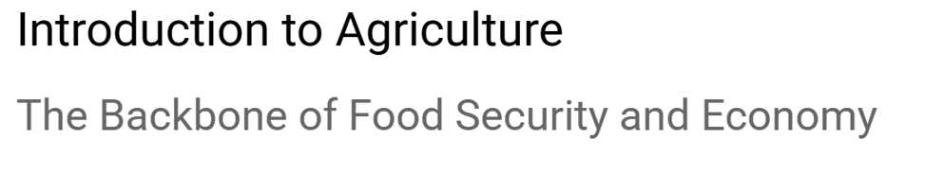
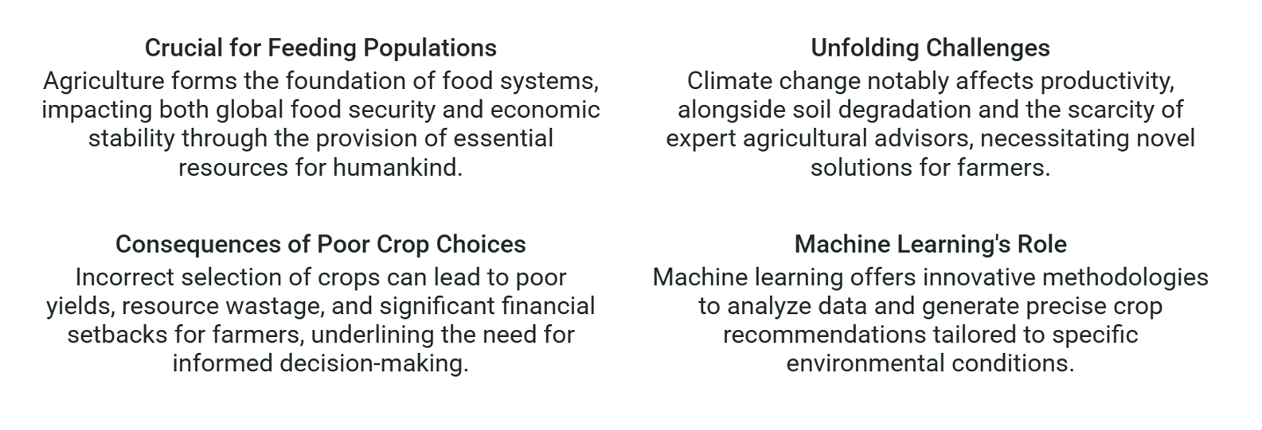

Slide 3
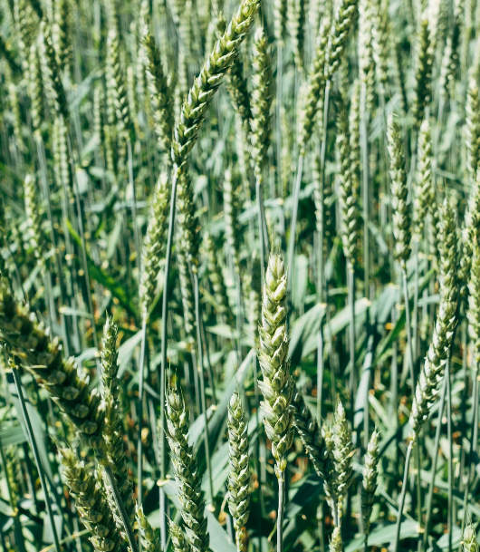
Research Question
How accurately can a machine learning model recommend suitable crops based on soil properties such as Nitrogen (N), Phosphorus (P), Potassium (K), and pH, along with environmental factors such as humidity, rainfall and temperature, in order to reduce crop failure?

Slide 4
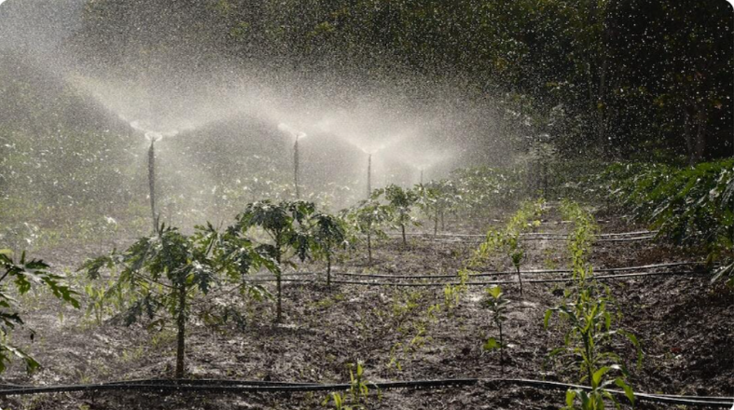
Objectives
Development and optimisation of a machine learning–based crop recommendation system using soil and environmental data.
Provide farmers with a practical decision-making tool that supports sustainable agriculture and improves yields.

Slide 5
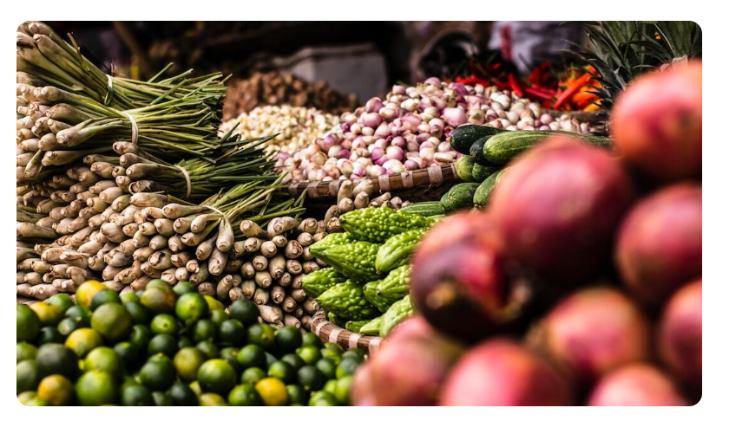
Methodology
Followed the CRISP-DM framework for data science research.
Dataset: 2200+ records with features such as nitrogen (N), phosphorus (P), potassium (K), pH, temperature, humidity, and rainfall.
Models tested: Decision Tree, Random Forest, K-Nearest Neighbours (KNN), Support Vector Classifier (SVC), and Extreme Gradient Boosting (XGBoost).
Evaluation metrics: Accuracy, Precision, Recall, and F1-score.
Deployment: A working prototype built with the Streamlit web app.

Slide 6
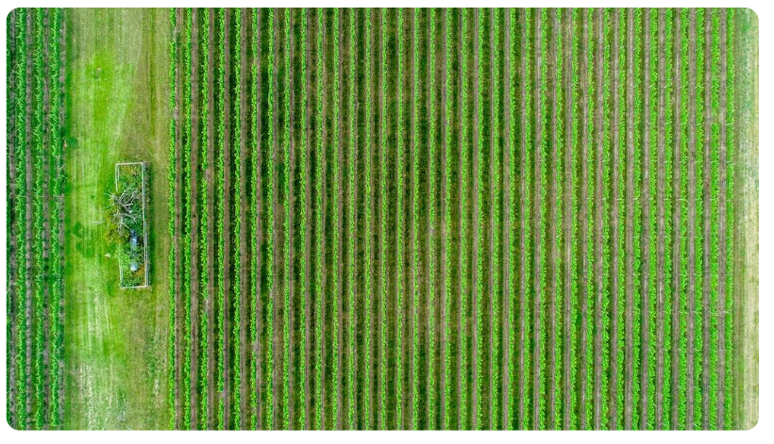
Results
Random Forest achieved the highest accuracy at 99.55%.
XGBoost followed closely with 99.09% accuracy.
SVC scored 98.79%, KNN 98.18%, and Decision Tree 97.88%.
The confusion matrix showed very few misclassifications across all crop classes.
Ensemble methods (Random Forest, XGBoost) clearly outperformed single models.

Slide 7
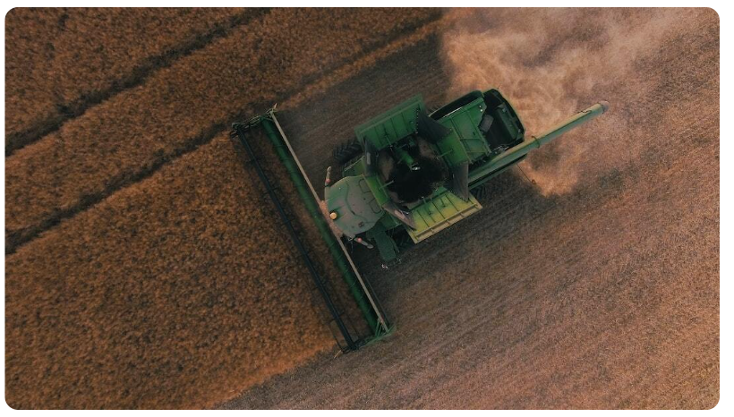
Discussion
Random Forest was chosen as the final model for deployment due to its accuracy and reliability.
The model was integrated into a Streamlit web app, providing a simple interface for farmers.
This makes the system lightweight, accessible, and practical for real-world use.
Limitations include reliance on a static dataset, no Internet of Things (IoT) sensor integration, and limited crop diversity.

Slide 8
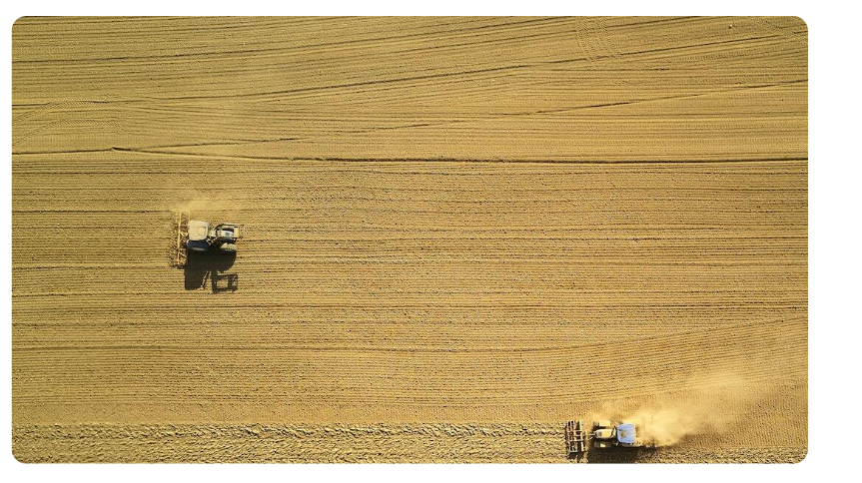
Conclusion
Objective 1 achieved: A crop recommendation system was developed and optimised, with Random Forest identified as the best model (99.55% accuracy).
Objective 2 achieved: The system was deployed as a Streamlit web app, ensuring usability for farmers.
The research question was answered positively: machine learning can recommend crops accurately.
This project bridges AI and agriculture, providing a foundation for future smart farming solutions.

Slide 9
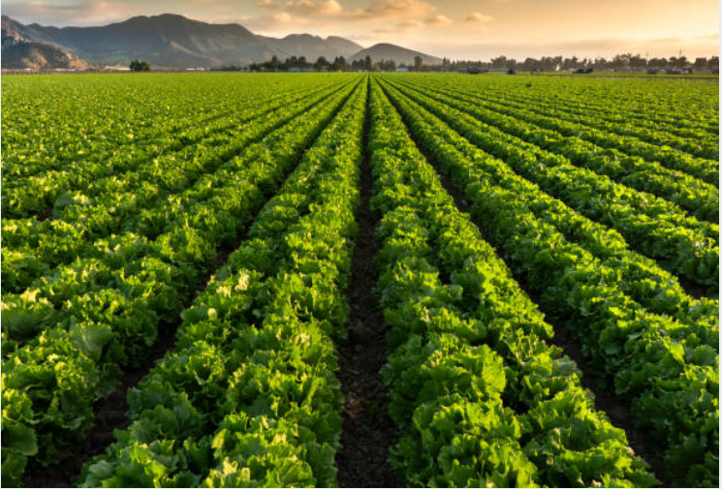
Future Work
Integrate Internet of Things (IoT) sensors for real-time soil and weather data.
Add Explainable Artificial Intelligence (XAI) features, such as SHAP or LIME, to improve transparency and trust.
Expand the system to mobile and offline versions for rural areas.
Introduce Application Programming Interface (API) connections with external data sources such as weather and pest alerts.
Include multi-language support for global accessibility.
Use larger, region-specific datasets to enhance generalisability.

